Slide 1
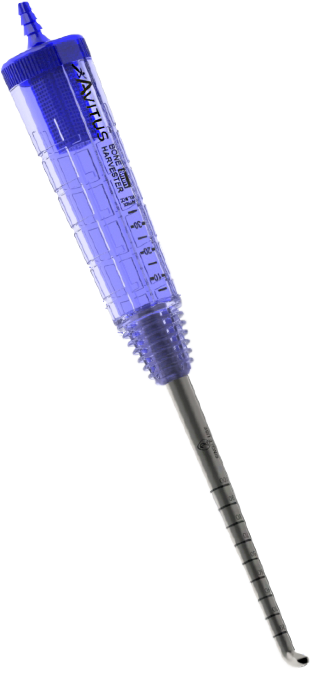
Avitus® Bone Harvester
Maximize Your
Gold Standard
Autograft Volume
Save Your Time
Save Cost vs. Alternatives
Easy Setup
Plug-and-play with
standard OR suction
Simply Retrieve Your Graft
Unscrew cap to retrieve graft
Avitus®
Marrow
See What You Harvest
Streamlined collection of autograft + bone marrow into the handle
Avitus®
Graft
Graft + marrow shown above harvested with the Avitus® Bone Harvester.
Amplify Your Harvest Efficiency
Automatically collect bone with each cut without passing back and forth into the harvest site
Description | Catalog #
Avitus® Bone Harvester – 8mm | BH8
See it in action at www.avitusortho.com.

